Slide 1

Knowledge Discovery from Natural Language Text
Day 12: Special Data Tyles – Natural Language Processing and Text Mining
Finding Needles in Wordstacks
A/Prof. Wei Liu & Tyler Bikaun
Computer Science and Software Engineering
wei.liu@uwa.edu.au
tyler.bikaun@research.uwa.edu.au

Slide 2
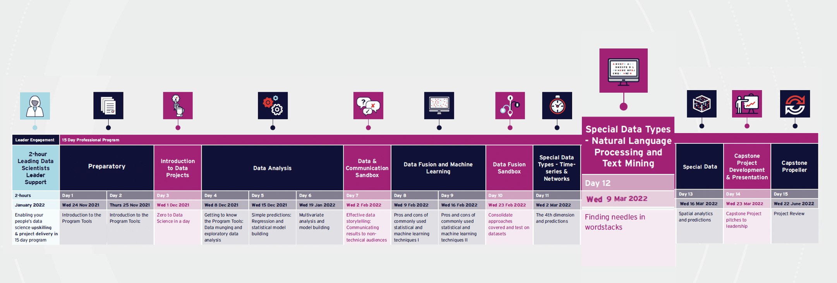
Day 12: Special Data Types - Natural Language Processing & Text Mining

Slide 3

12
Understand practical strategies and applications for using text
Provide a foundation for NLP fundamentals including text wrangling, pre-processing, and representation
Gain familiarity with supervised and unsupervised learning
Understand the natural language annotation process
Understand how to wrangle, pre-process and gain insight into text
Perform a range of supervised learning tasks
Understand the text annotation process
Perform unsupervised learning
Notes:
Previous text
Aims
1. Extract text to run ML pipelines over
2. Present the practical strategies for using text
Learning Outcomes
1. Understand how to handle text
2. Understand text pre-processing
3. Demonstrate text with supervised and unsupervised learning

Slide 4
Day 12: Special Data Types - Natural Language Processing & Text Mining

Slide 5
A day on Natural Language Processing and Text Mining
Knowledge Representation
Machine Learning
Computational Linguistic
What is today about?
Natural Language Processing
Language Representation
Supervised Learning
Natural Language Annotation
Unsupervised Learning
Associate Prof. Wei Liu & Tyler Bikaun, UWA
Notes:
Previous text
What is today about?
- Natural language processing
- Word embeddings
- Topic modelling
- Information extraction
- Sentiment detection

Slide 6
Schedule
AWST | AEST | Agenda | Facilitator(s)
07:30 | 09:30 | Q&A, Issues & Announcements | Tamryn/Wei/Tyler
07:45 | 09:45 | 12.0 Overview 12.1 Fundamentals of NLP | Wei Tyler
09:15 | 11:15 | Morning Tea
09:30 | 11:30 | 12.2 Fundamentals of NLP 12.3 Supervised Learning | Tyler
11:00 | 13:00 | Lunch
11:45 | 13:45 | 12.3 Supervised Learning | Tyler
13:15 | 15:15 | Afternoon Tea
13:30 | 15:30 | Project Update | All/Tamryn
14:00 | 16:00 | 12.4 Unsupervised Learning | Tyler
14:30 | 16:30 | Closeout & Takeaways | Wei/Tyler
14:55 | 16:55 | Menti Feedback | Tamryn
15:00 | 17:00 | Close
Associate Prof. Wei Liu & Tyler Bikaun, UWA

Slide 7
12.0 Overview
What can we get out of natural language texts

Slide 8
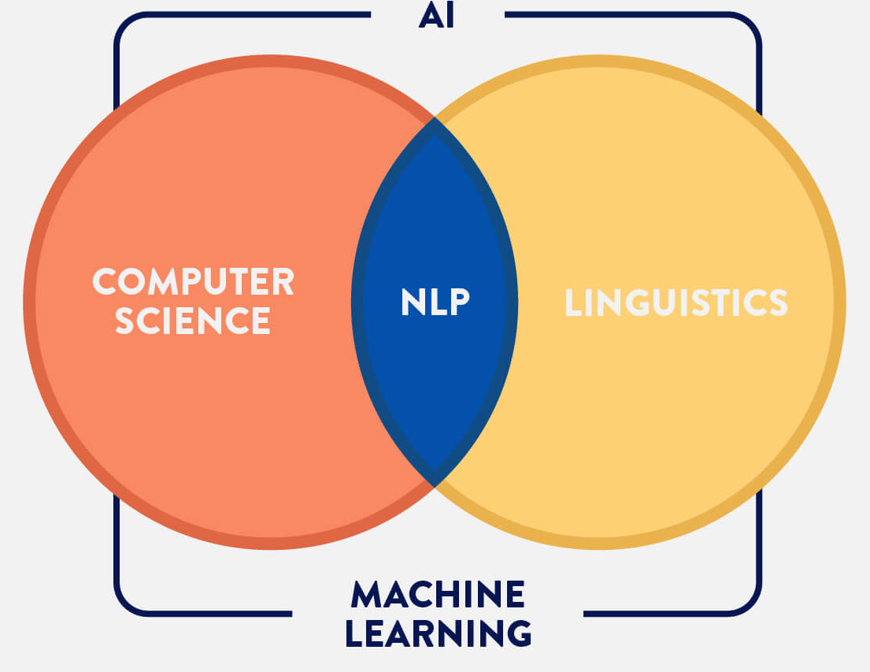
Tasks in Natural Language Processing¹
NLP Tasks
Data-to-Text Generation
Grammatical error correction
Lexical normalization
Machine translation
Named entity recognition
Question answering
Relation extraction
Sentiment Analysis
Simplification
Summarization
Text classification
…
Associate Prof. Wei Liu & Tyler Bikaun, UWA 1 - http://nlpprogress.com/
Notes:
Motivate the field of NLP through it’s wide variety of powerful applications
Classical approaches e.g. engineered pipelines vs. data-driven neural approaches (our focus here)

Slide 9
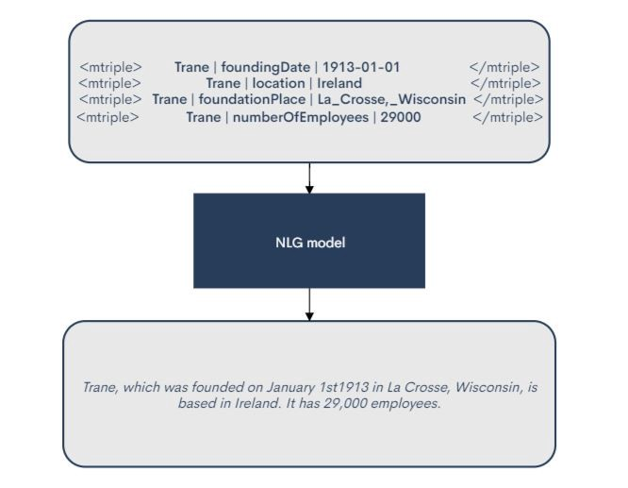
Tasks in Natural Language Processing¹
NLP Tasks
Data-to-Text Generation
Grammatical error correction
Lexical normalization
Machine translation
Named entity recognition
Question answering
Relation extraction
Sentiment Analysis
Simplification
Summarization
Text classification
…
Associate Prof. Wei Liu & Tyler Bikaun, UWA 1 - http://nlpprogress.com/
Notes:
https://miro.medium.com/max/666/1*cpwgfaZmO6SBH5nJc379Ig.jpeg

Slide 10
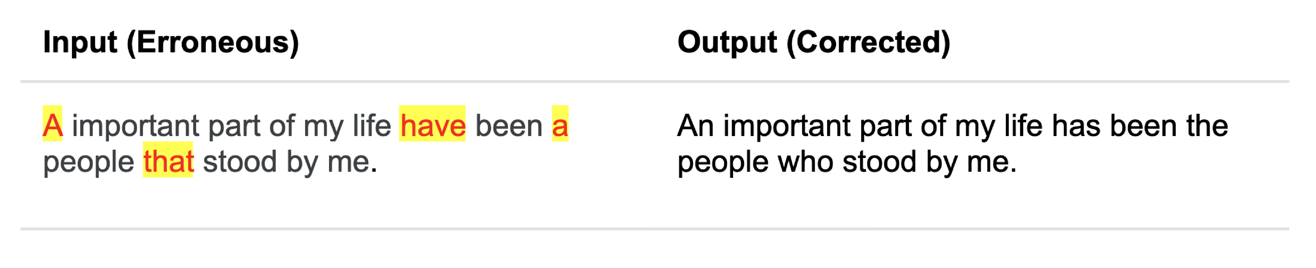
Tasks in Natural Language Processing¹
NLP Tasks
Data-to-Text Generation
Grammatical error correction
Lexical normalization
Machine translation
Named entity recognition
Question answering
Relation extraction
Sentiment Analysis
Simplification
Summarization
Text classification
…
Associate Prof. Wei Liu & Tyler Bikaun, UWA 1 - http://nlpprogress.com/
Notes:
https://www.grammarly.com/blog/engineering/adversarial-grammatical-error-correction/

Slide 11
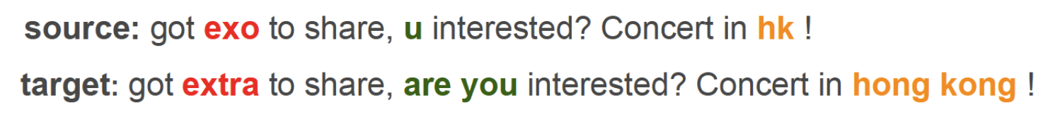
Tasks in Natural Language Processing¹
NLP Tasks
Data-to-Text Generation
Grammatical error correction
Lexical normalization
Machine translation
Named entity recognition
Question answering
Relation extraction
Sentiment Analysis
Simplification
Summarization
Text classification
…
Associate Prof. Wei Liu & Tyler Bikaun, UWA 1 - http://nlpprogress.com/
Notes:
Pic: Adapting sequence to sequence models for text normalization in social media (Lourentzou, et al. 2019)

Slide 12
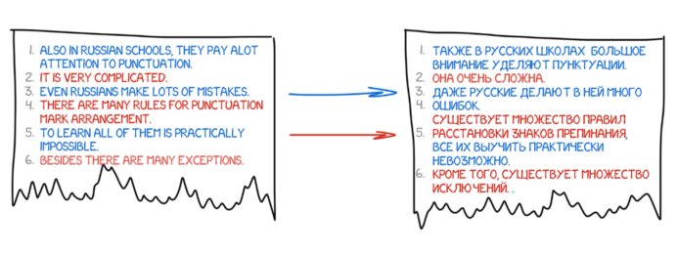
Tasks in Natural Language Processing¹
NLP Tasks
Data-to-Text Generation
Grammatical error correction
Lexical normalization
Machine translation
Named entity recognition
Question answering
Relation extraction
Sentiment Analysis
Simplification
Summarization
Text classification
…
Associate Prof. Wei Liu & Tyler Bikaun, UWA 1 - http://nlpprogress.com/
Notes:
https://cdn-media-1.freecodecamp.org/images/5qBpooShbY6xVngSotA6KINHyHP7NKeTJryb

Slide 13
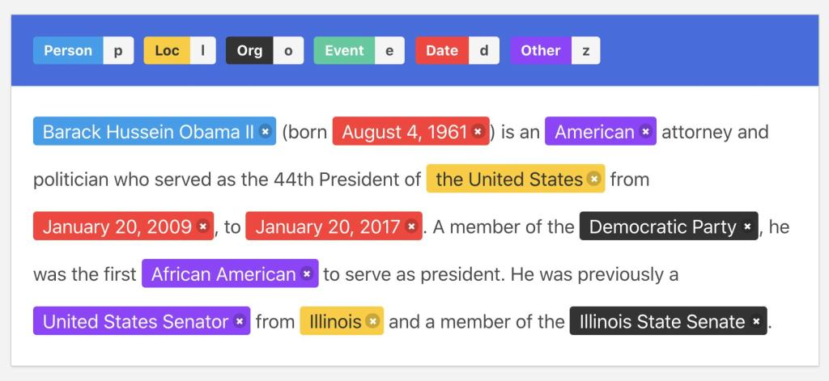
Tasks in Natural Language Processing¹
NLP Tasks
Data-to-Text Generation
Grammatical error correction
Lexical normalization
Machine translation
Named entity recognition
Question answering
Relation extraction
Sentiment Analysis
Simplification
Summarization
Text classification
…
Associate Prof. Wei Liu & Tyler Bikaun, UWA 1 - http://nlpprogress.com/
Notes:
https://editor.analyticsvidhya.com/uploads/19617Intro%20image.jpg

Slide 14
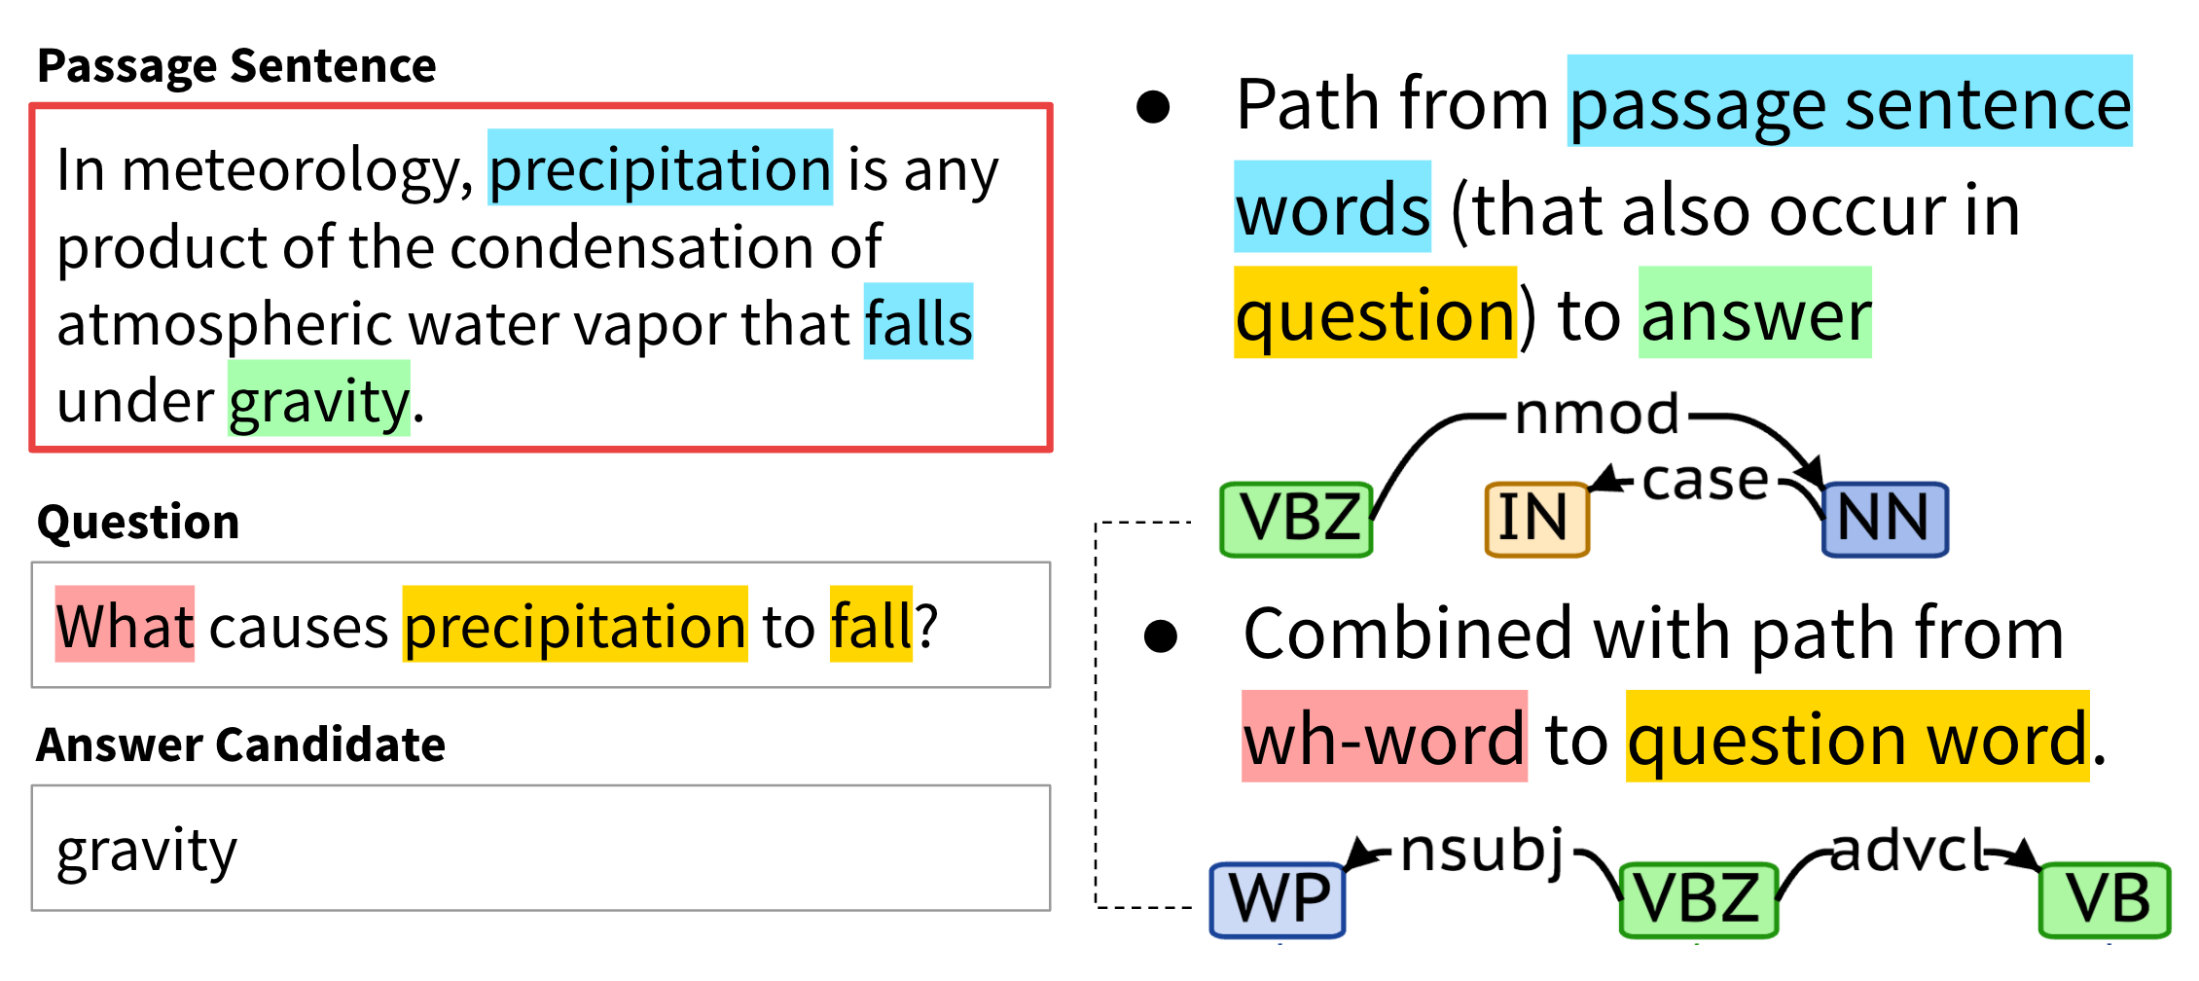
Tasks in Natural Language Processing¹
NLP Tasks
Data-to-Text Generation
Grammatical error correction
Lexical normalization
Machine translation
Named entity recognition
Question answering
Relation extraction
Sentiment Analysis
Simplification
Summarization
Text classification
…
Associate Prof. Wei Liu & Tyler Bikaun, UWA 1 - http://nlpprogress.com/

Slide 15
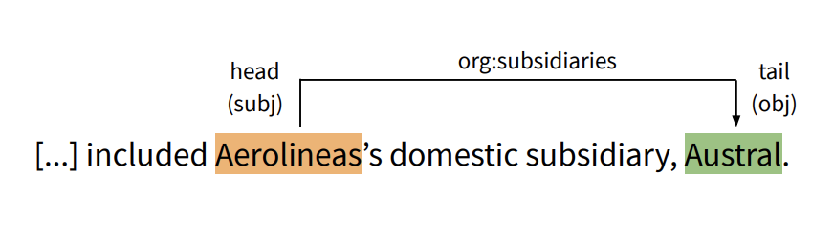
Tasks in Natural Language Processing¹
NLP Tasks
Data-to-Text Generation
Grammatical error correction
Lexical normalization
Machine translation
Named entity recognition
Question answering
Relation extraction
Sentiment Analysis
Simplification
Summarization
Text classification
…
Associate Prof. Wei Liu & Tyler Bikaun, UWA 1 - http://nlpprogress.com/

Slide 16
Tasks in Natural Language Processing¹
NLP Tasks
Data-to-Text Generation
Grammatical error correction
Lexical normalization
Machine translation
Named entity recognition
Question answering
Relation extraction
Sentiment Analysis
Simplification
Summarization
Text classification
…
Associate Prof. Wei Liu & Tyler Bikaun, UWA 1 - http://nlpprogress.com/

Slide 17
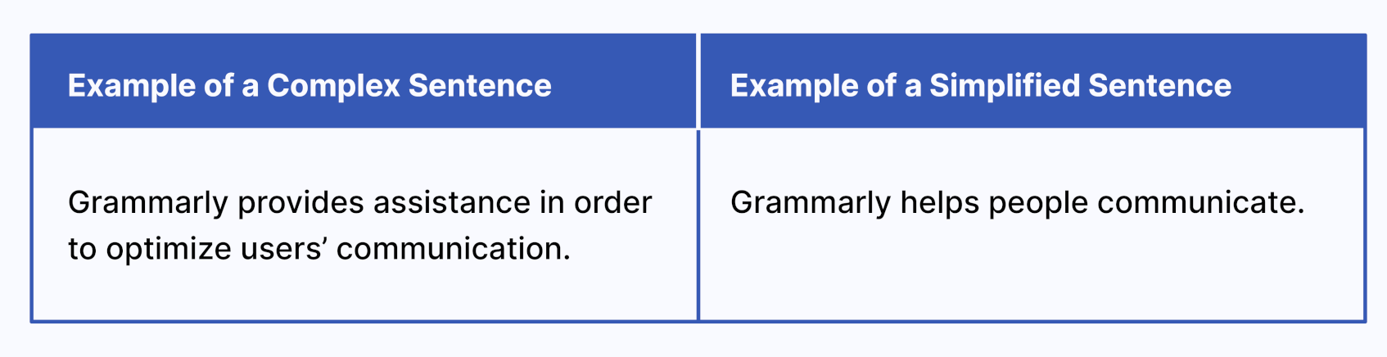
Tasks in Natural Language Processing¹
NLP Tasks
Data-to-Text Generation
Grammatical error correction
Lexical normalization
Machine translation
Named entity recognition
Question answering
Relation extraction
Sentiment Analysis
Simplification
Summarization
Text classification
…
Associate Prof. Wei Liu & Tyler Bikaun, UWA 1 - http://nlpprogress.com/

Slide 18
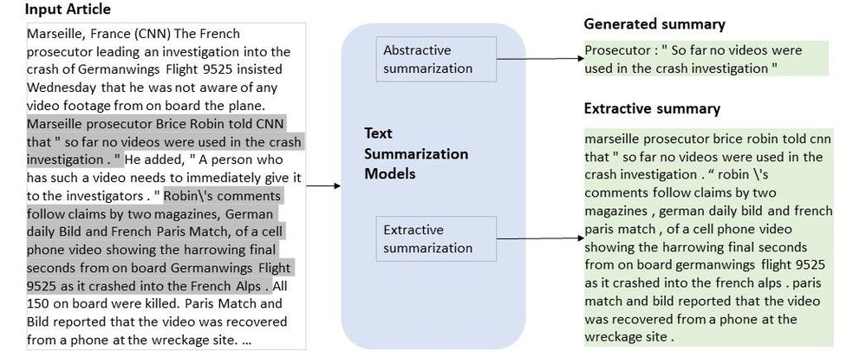
Tasks in Natural Language Processing¹
NLP Tasks
Data-to-Text Generation
Grammatical error correction
Lexical normalization
Machine translation
Named entity recognition
Question answering
Relation extraction
Sentiment Analysis
Simplification
Summarization
Text classification
…
Associate Prof. Wei Liu & Tyler Bikaun, UWA 1 - http://nlpprogress.com/

Slide 19

Tasks in Natural Language Processing¹
NLP Tasks
Data-to-Text Generation
Grammatical error correction
Lexical normalization
Machine translation
Named entity recognition
Question answering
Relation extraction
Sentiment Analysis
Simplification
Summarization
Text classification
…
Associate Prof. Wei Liu & Tyler Bikaun, UWA 1 - http://nlpprogress.com/

Slide 20
Our Work and Projects

Slide 21

Natural and Technical Language Processing
Natural Language Processing
Technical Language Processing
Natural language processing (NLP) is the study of getting computers to understand natural languages.
You probably make use of NLP every day!
Google search
Spellcheckers
Siri
Autocomplete
Technical language processing (TLP) aims to understand technical languages, a subset of natural languages that appears in industry-specific contexts.
Accident reports: | WAlking in car park from office to workshop & roled ankle Injured right wrist lifting wheel barrow off ute
Maintenance work orders: | a/c blowing hot air repace grouser plate to l/h side track
Associate Prof. Wei Liu & Tyler Bikaun, UWA NLP-TLP Research Group at UWA: http://nlp-tlp.org/
Notes:
https://nlp-tlp.org/
NTLP Research Group at UWA: http://nlp-tlp.org/

Slide 22
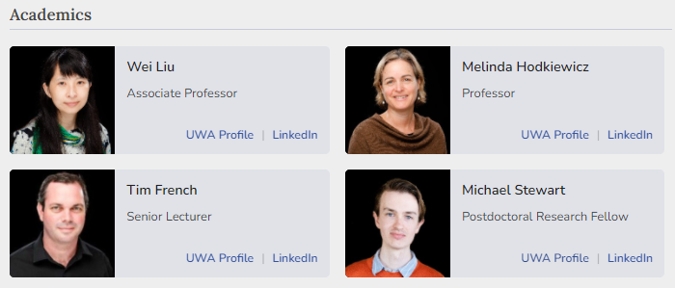
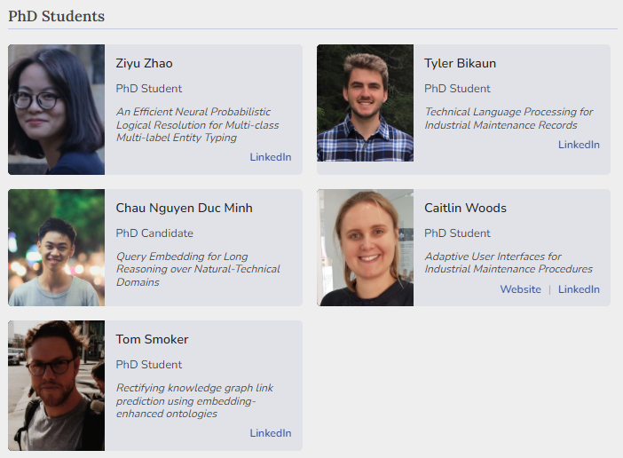
Natural and Technical Language Processing
Our Team
+ masters and honours students
Associate Prof. Wei Liu & Tyler Bikaun, UWA

Slide 23
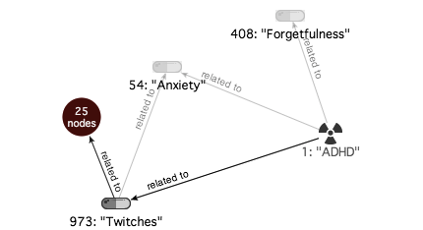
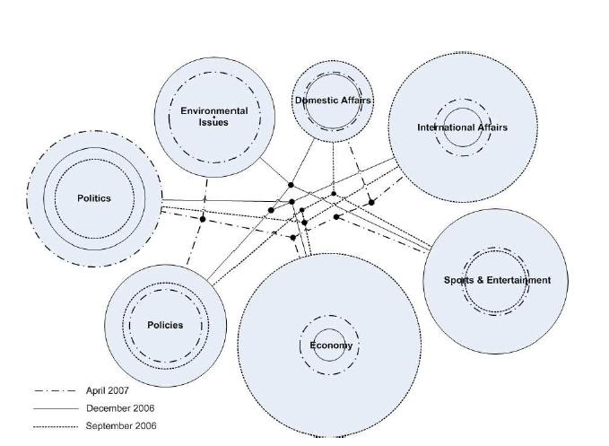
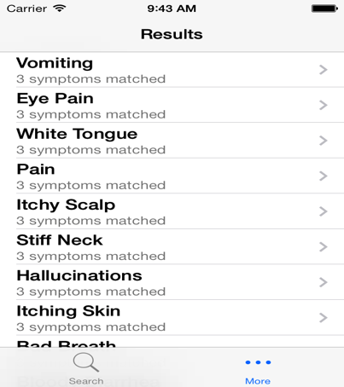
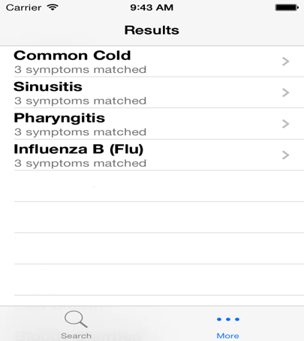
Past Projects
News, Academic Publication and Medical Diagnosis
Election predication (news article analysis)
Medical diagnosis
PubMed Article Analysis
Associate Prof. Wei Liu & Tyler Bikaun, UWA

Slide 24
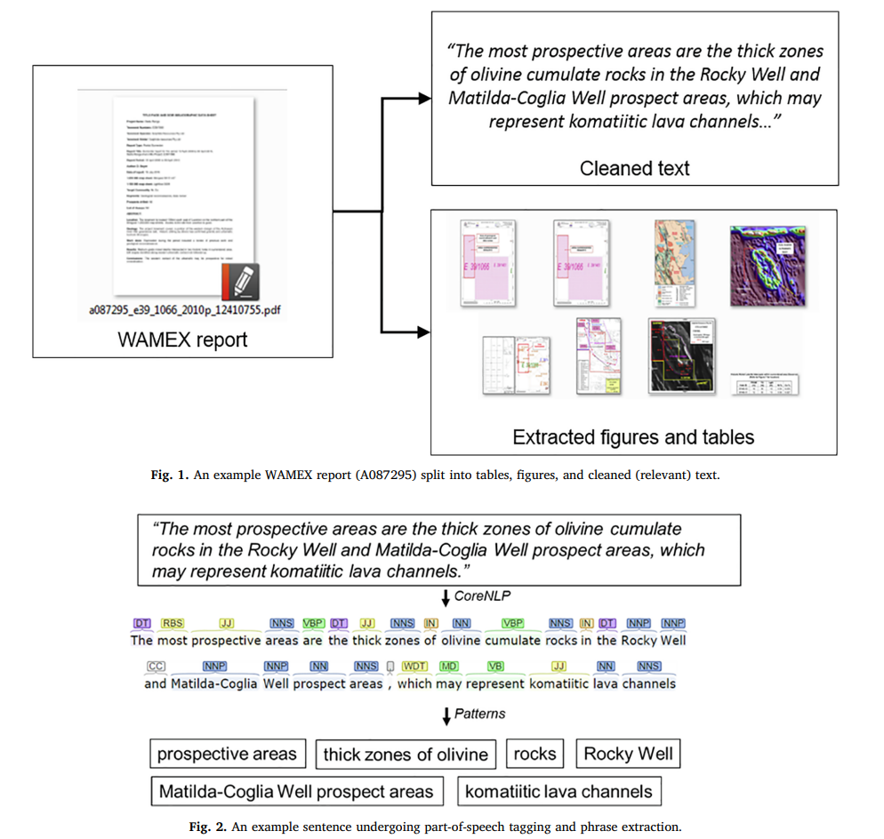
Past Projects
Geological Information Extraction
Associate Prof. Wei Liu & Tyler Bikaun, UWA
Notes:
Enkhsaikhan, Majigsuren, Wei Liu, Eun-Jung Holden, and Paul Duuring. "Auto-labelling entities in low-resource text: a geological case study." Knowledge and Information Systems 63, no. 3 (2021): 695-715.

Slide 25
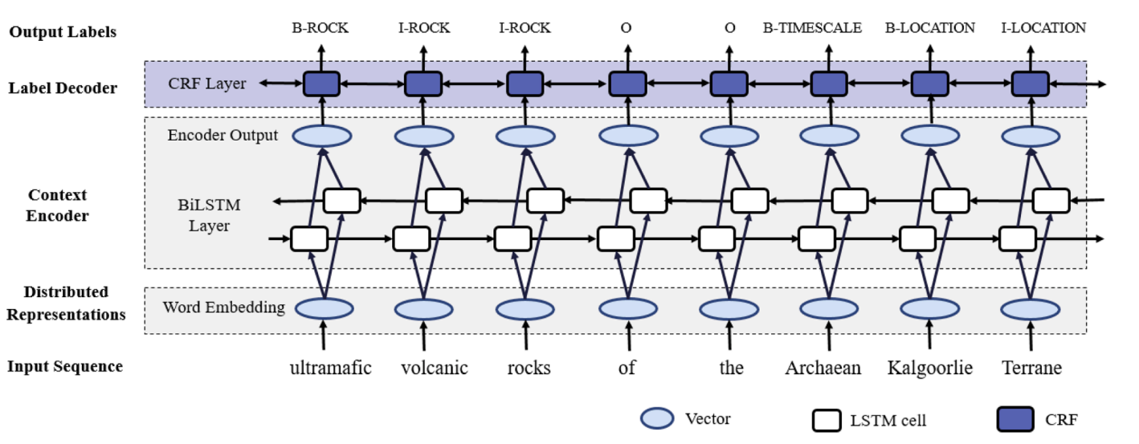
Past Projects
Geological Information Extraction
Associate Prof. Wei Liu & Tyler Bikaun, UWA
Notes:
Enkhsaikhan, Majigsuren, Wei Liu, Eun-Jung Holden, and Paul Duuring. "Auto-labelling entities in low-resource text: a geological case study." Knowledge and Information Systems 63, no. 3 (2021): 695-715.

Slide 26
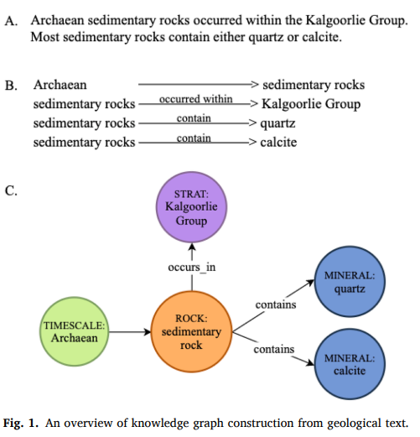
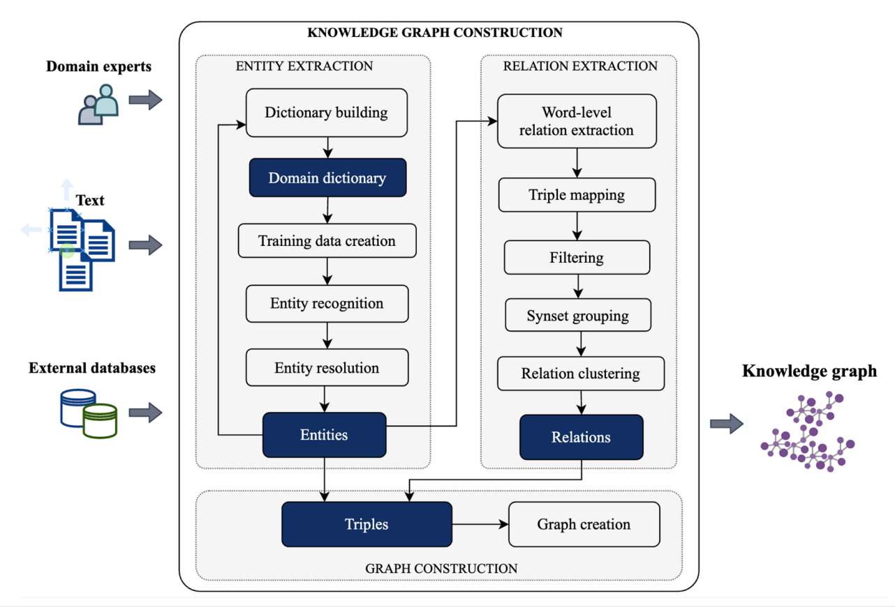
Past Projects
Geological Information Extraction
Associate Prof. Wei Liu & Tyler Bikaun, UWA
Notes:
Enkhsaikhan, Majigsuren, Wei Liu, Eun-Jung Holden, and Paul Duuring. "Auto-labelling entities in low-resource text: a geological case study." Knowledge and Information Systems 63, no. 3 (2021): 695-715.

Slide 27

Past Projects
Aquila – Knowledge Discovery from Mining Safety Data
Aquila is a web-based tool for visualising and analysing technical records.
It is designed to be usable by anyone – no programming experience required.
It features a range of unique visualisations that support knowledge discovery.
Associate Prof. Wei Liu & Tyler Bikaun, UWA
Notes:
M Stewart, W Liu, R Cardell-Oliver, M Griffin. An Interactive Web-based Toolset for Knowledge Discovery from Short Text Log Data. 2017 International Conference on Advanced Data Mining and Applications, 853-858.

Slide 28
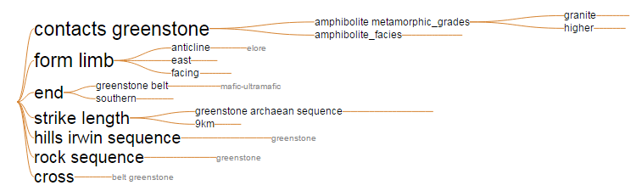
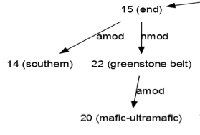
GSWA
Exploration
Report
Part-of-Speech Tagging & Grammar Tree
Stanford Dependency Parser
Grammatically parse sentences in each report
Parts of speech (e.g., nouns, verbs, and adjectives)
Relationships between words (e.g., modifiers, compounds)
Dictionary
Build from a variety of geology related resources
General geology dictionary
Schlumberger oilfields glossary
Other web sources (webpages, databased etc)
Clean extracted terms
Lemmatisation
Noise removal
Noun Phrase Chunker
Summary Graphs & Visualisation
Identify noun phrases
Find complete noun phrases, such as ‘Archean greenstone belt’
Document normalising-splitting sentences-noun phrase identification (using Part-of-Speech pattern)
e.g. <NN.*|JJ>*<NN.*> -- Nouns and Adjectives, terminated with Nouns
Merge grammar tree
Merge compound nouns together, keep modifiers
Provides a visual summary of the report
Page Ranking & Key Noun Phrases
Extract key phrases
Keep phrases if they match our dictionary
Provides key phrase summaries of the report
hole, located, drilling, sequence, work, nickel laterite, mapping, exploration, body, range, bif, potential, period, belt, deposit, terrane, amphibolite, mineralisation, …

Slide 29
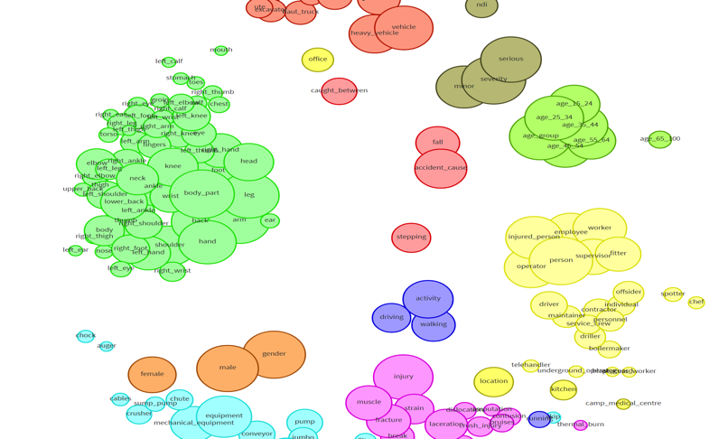
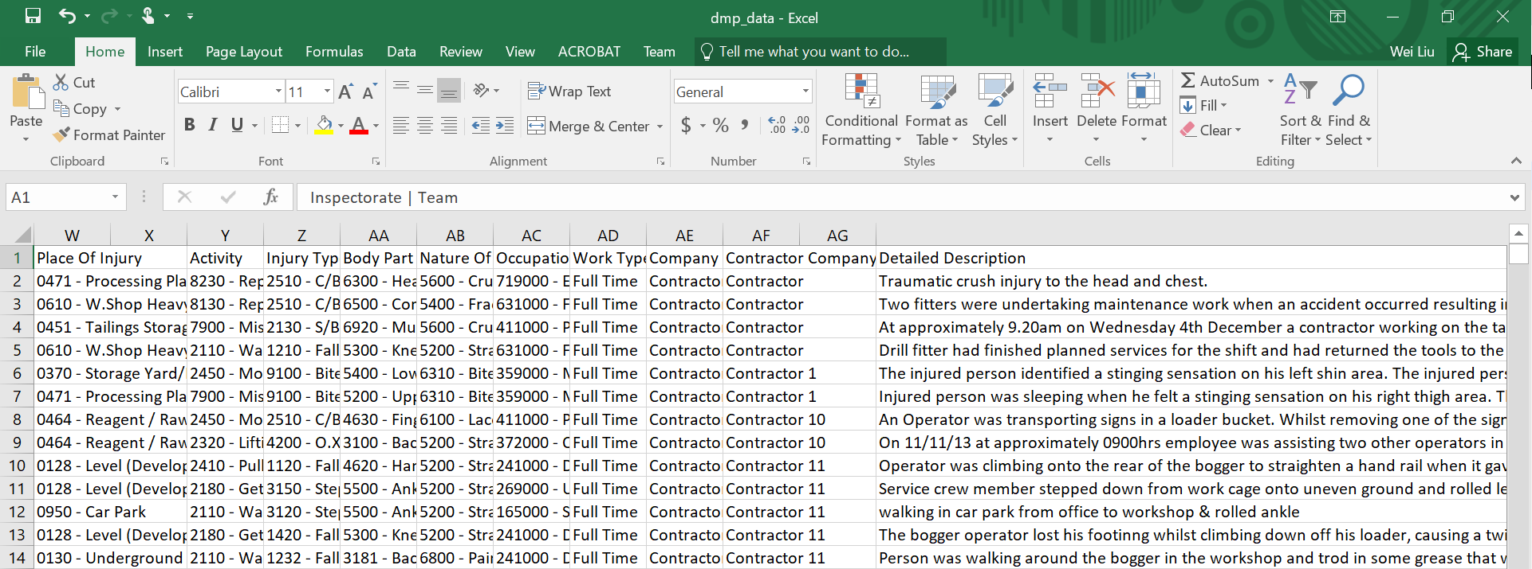
S³ - Semantics
Extracting Semantics – Association Rule Mining
Aquilia – Text Mining (https://nlp-tlp.org/aquila)
Associate Prof. Wei Liu & Tyler Bikaun, UWA

Slide 30
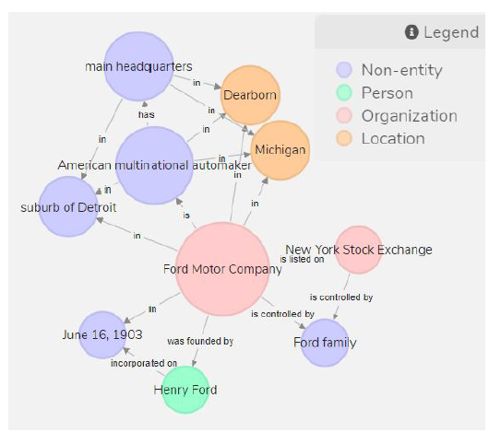
S³ - Semantics
Extracting Semantics – Knowledge Graph Construction from Text
Text2KG (https://nlp-tlp.org/text2kg)
Ford Motor Company is an American multinational automaker that has its main headquarters in Dearborn, Michigan, a suburb of Detroit. The company was founded by Henry Ford and incorporated on June 16, 1903. The company is listed on the New York Stock Exchange and it is controlled by the Ford family.
Associate Prof. Wei Liu & Tyler Bikaun, UWA
Notes:
Knowledge Graph Construction from Text - https://nlp-tlp.org/text2kg

Slide 31
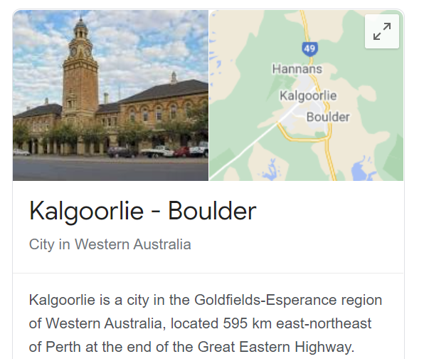
S³ – Social
Extracting Social Relations between words
Kalgoorlie + iron-ore – gold = ?
Associate Prof. Wei Liu & Tyler Bikaun, UWA

Slide 32
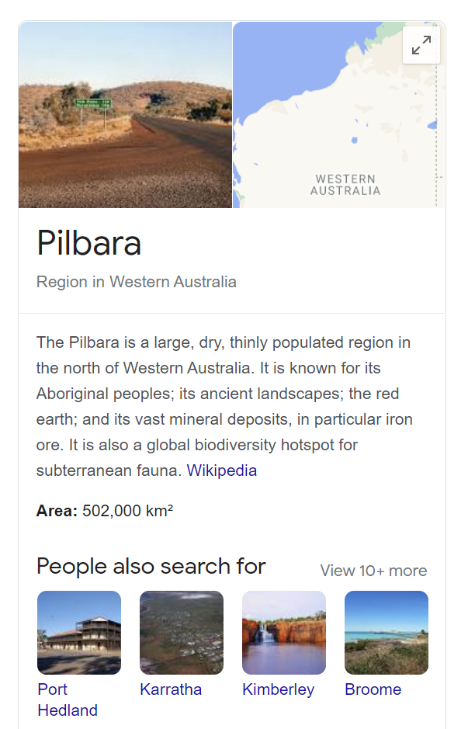
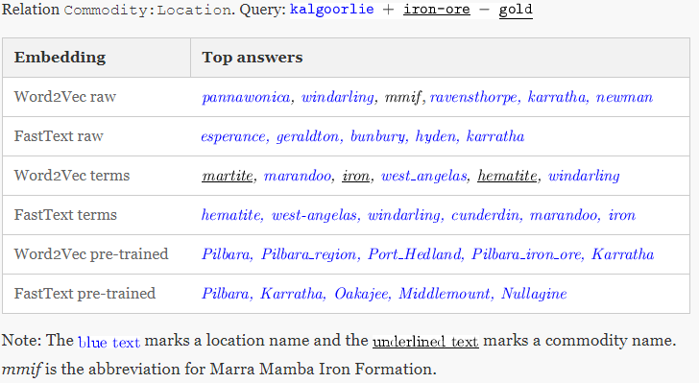
S³ - Social
Extracting Social Relations between words
Associate Prof. Wei Liu & Tyler Bikaun, UWA

Slide 33
S³ - Sentiment
Extracting Sentiment from Text
Associate Prof. Wei Liu & Tyler Bikaun, UWA

Slide 34
S³ - Sentiment
Extracting Sentiment from Text
Dow Jones
CALM
Associate Prof. Wei Liu & Tyler Bikaun, UWA
Notes:
Johan Bollen, Huina Mao, Xiaojun Zeng. 2011. Twitter mood predicts the stock market,
Journal of Computational Science 2:1, 1-8. 10.1016/j.jocs.2010.12.007.

Slide 35

Current Projects
Maintenance Work Order Processing - ARC Training Centre for Transforming Maintenance through Data Science
Associate Prof. Wei Liu & Tyler Bikaun, UWA
Notes:
Maintenance Work Order Processing - ARC Training Centre for Transforming Maintenance through Data Science
https://www.maintenance.org.au/category/rt1

Slide 36
Short Text Taxonomy
Short text
Low quality
High quality
Technical language
Domain-specific
Mixed domain
Domain-specific
Mixed domain
Accident reports
Maintenance work orders
Doctor’s notes
Social media posts
Emails
Text messages
Academic documents
Movie reviews
Wiki documents
News reports
Books
Associate Prof. Wei Liu & Tyler Bikaun, UWA
Notes:
Slide courtesy of Dr Michael Stewart’s PhD Thesis

Slide 37
Knowledge Graph Construction from Text – Text2KG Pipeline
Knowledge Graph Construction From Text
A knowledge graph (KG) is a graph-structured knowledge base that stores knowledge in the form of the relation between entities.
Subtasks of Knowledge Graph Construction
Entity Extraction
Relation Extraction
Axiom Extraction
Note that we do not attempt to link to an existing KG such as Freebase, DBPedia, YAGO, and NELL.
Associate Prof. Wei Liu, UWA

Slide 38
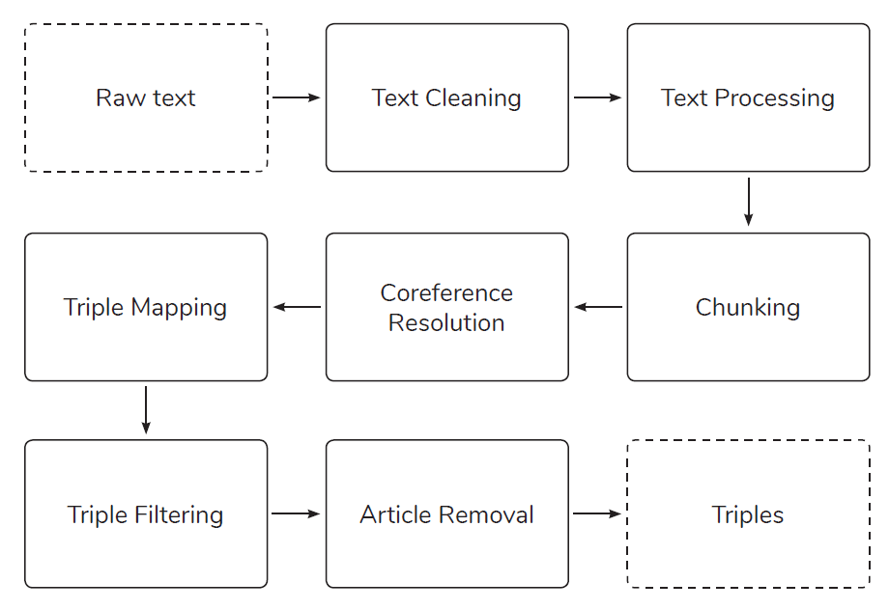
Knowledge Graph Construction from Text
ICDM Knowledge Graph Contest 2019
M. Stewart, M. Enkhsaikhan and W. Liu, "ICDM 2019 Knowledge Graph Contest: Team UWA," 2019 IEEE International Conference on Data Mining (ICDM), Beijing, China, 2019, pp. 1546-1551.
Associate Prof. Wei Liu, UWA

Slide 39
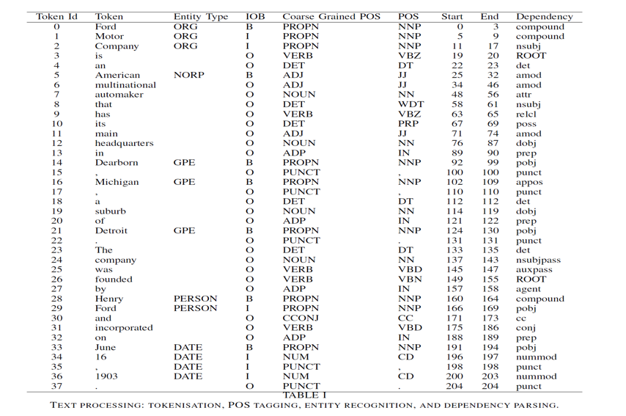
Knowledge Graph Construction from Text
Text Cleaning and Text Processing
Text Cleaning: special
characters such as hyphen and quotation marks and also break
sentences joined together with no space between them.
Text processing: The text is processed through tokenisation,
POS tagging, entity recognition and dependency parsing
steps using SpaCy.
Associate Prof. Wei Liu, UWA

Slide 40
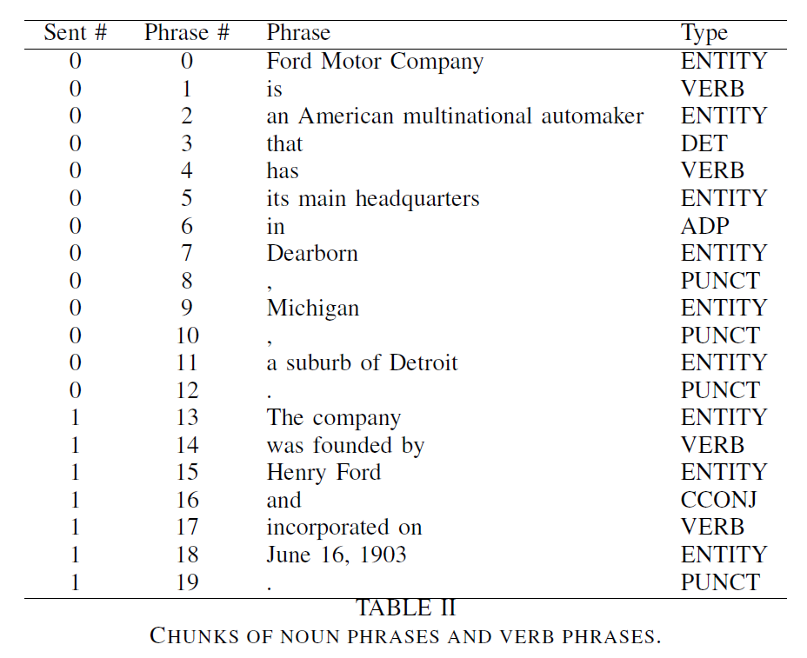
Knowledge Graph Construction from Text
Phrase Identification – Linguistic Rules
Noun Phrase Chunking:
NP
(NP)
NP + of + NP
NP + NP
Verb Phrase Chunking:
VERB + PART
VERB + ADP
ADP + VERB
PART + VERB11ERB
Associate Prof. Wei Liu, UWA

Slide 41
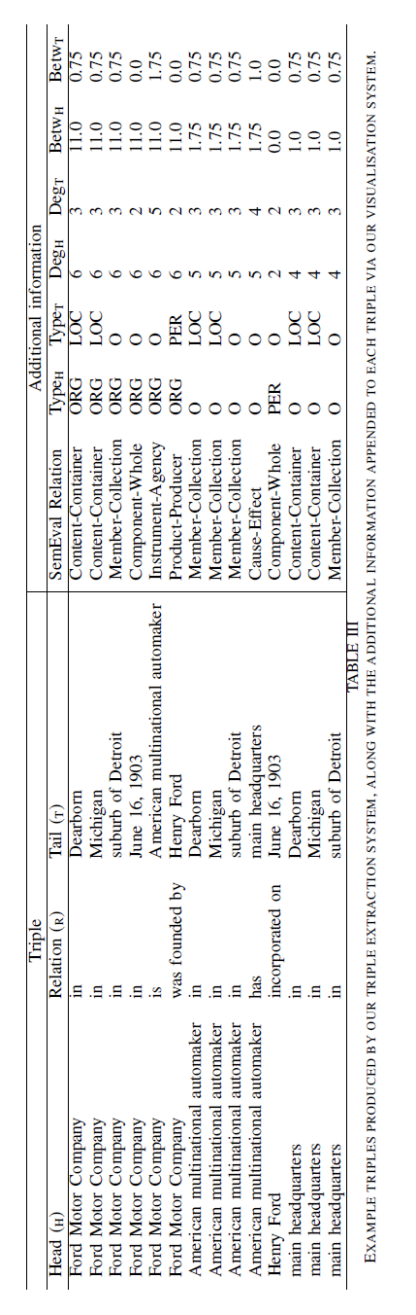
Knowledge Graph Construction from Text
Triple Creation and Filtering
COREF Resolution *:
Coreference items are resolved by replacing the original phrase with the referred phrase for each item.
Triple Creation: Find triples in the same sentence by finding entities before and after verb phrases;
Document-level triples are obtained by finding shortest path between any pair of entities.
Triple Filtering: remove any triple with a stop word as a head entity. The stop words include NLTK stop words,
names of days (e.g. Monday) and names of months (e.g. January).
Article Removal: articles (a, an, the), possessive pronouns
(e.g., its, their) and demonstrative pronouns (e.g., that, these) are removed from the heads and tails.
NeuralCoref: https://github.com/huggingface/neuralcoref

Slide 42
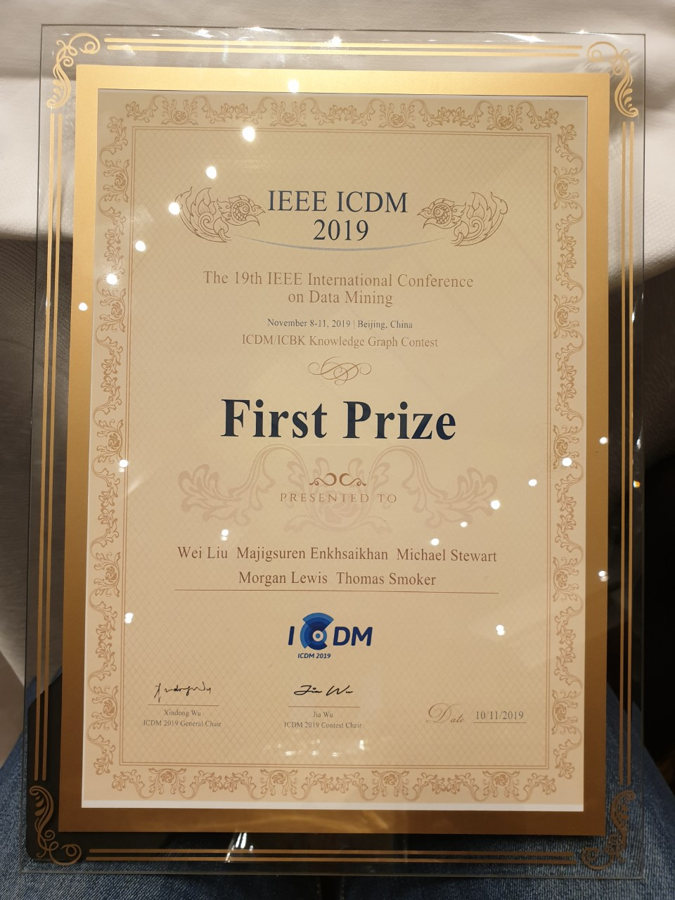
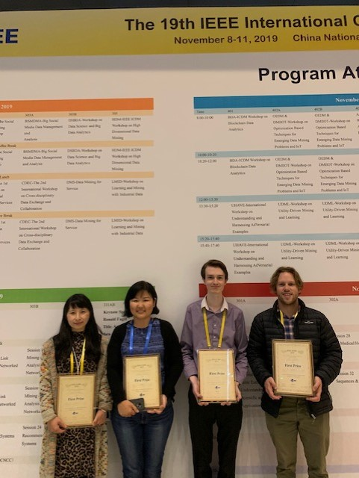
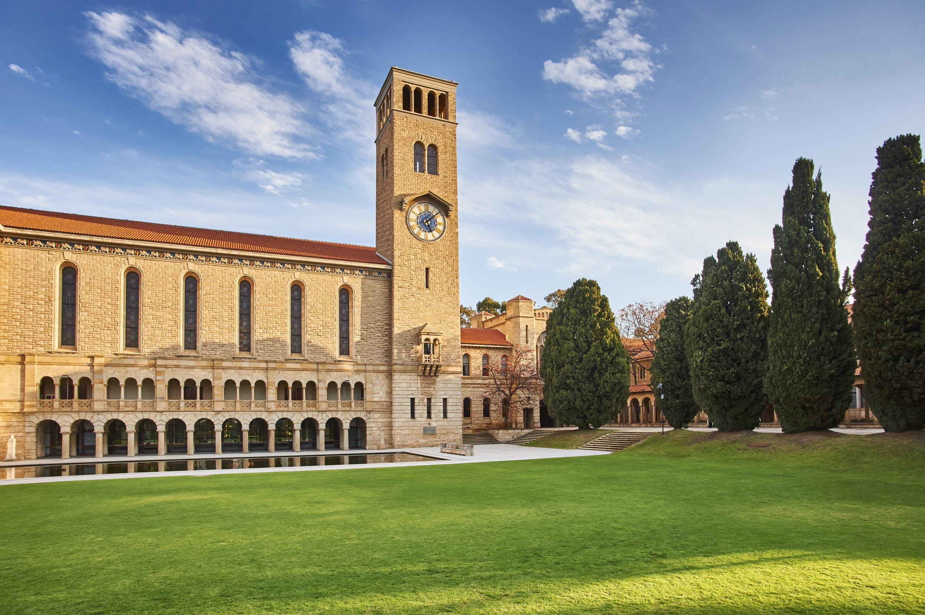
Text2KG: ICDM Knowledge Graph Contest – First Prize
Associate Prof. Wei Liu, UWA

Slide 43
12.1 Fundamentals of NLP
Text wrangling, pre-processing and analysis
Notes:
Handling –
Processing –
Representation -

Slide 44
Fundamentals of Natural Language Processing
Agenda (Hands-on Session) - An introduction to the Natural Language Tool Kit (NLTK)
Tokenization
Stop-words
Feature distributions
N-grams
Stemming
Concordancing
Dispersion plotting
Bi-gram significance
Word contexts
Word similarities
Parts-of-Speech (POS)
Named entity recognition
Associate Prof. Wei Liu & Tyler Bikaun, UWA Notebook: 12.1 – An Introduction to the NLTK

Slide 45
12.2 Fundamentals of NLP
Representing natural language

Slide 46
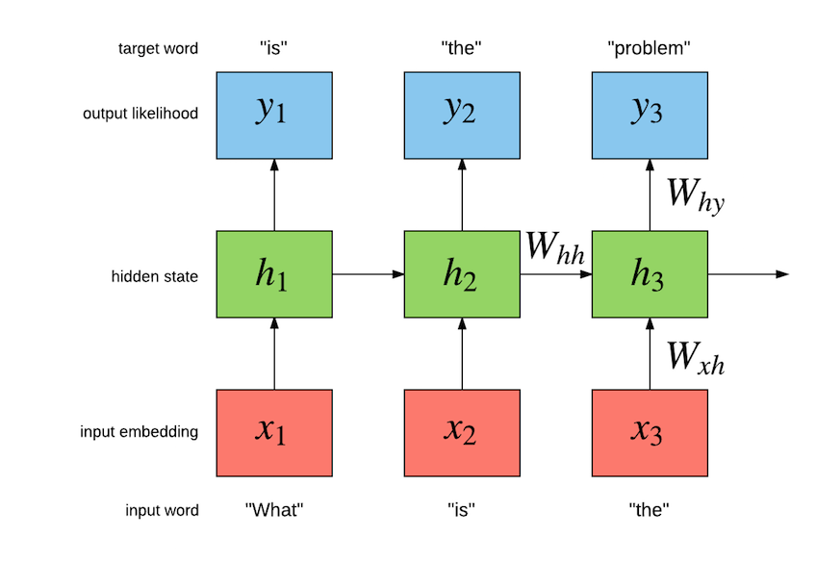
Word Embeddings: One-hot Vectors
Word representations – one-hot vectors
What is the name of the prime minister of Australia?
What | = | [10000000]
is | = | [01000000]
the | = | [00100000]
name | = | [00010000]
of | = | [00001000]
the | = | [00100000]
prime | = | [00000100]
minister | = | [00000010]
of | = | [00001000]
Australia | = | [00000001]
(Socher, 2018)
Associate Prof. Wei Liu & Tyler Bikaun, UWA
Notes:
How do we represent words?
One hot encoding (count vectorising); basic, naïve.
Vector dimension becomes as large as the number of words in the vocabulary. This is not ideal for large ML systems. Orthogonality
Socher, R. (2018, January 18). Natural Language Processing with Deep Learning CS224N/Ling284 [PowerPoint slides]. https://web.stanford.edu/class/archive/cs/cs224n/cs224n.1184/lectures/lecture2.pdf

Slide 47
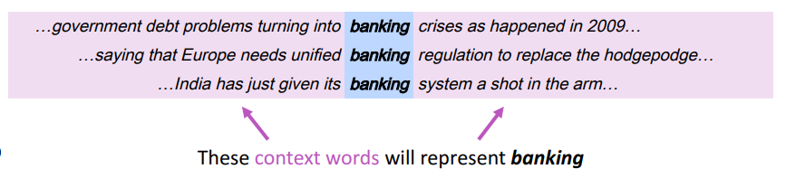
Word Embeddings: Learning Context
Representing words by their context
You shall know a word by the company it keeps
J. R. Firth 1957
prime | = | [0,0,0,0,0,1,0,0]
minister | = | [0,0,0,0,0,0,1,0]
prime | = | [-0.1, 0.1, 0.2, 0.3, 0.3, 0.4, 0.1, 0.7]
minister | = | [-0.2, 0.2, 0.4, 0.2, 0.2, 0.2, 0.1, 0.6]
One-hot
Embeddings
Associate Prof. Wei Liu & Tyler Bikaun, UWA
Notes:
How do we capture semantic and syntactic similarities, relationships with other words, etc.
Concordance
“You shall know a word by the company it keeps” (J. R. Firth 1957: 11)
Distribution representations of words; that is, we want to introduce dependence between words. We are unable to determine similarity between one hot vectors because they’re orthogonal e.g. their dot product is zero.
Socher, R. (2018, January 18). Natural Language Processing with Deep Learning CS224N/Ling284 [PowerPoint slides]. https://web.stanford.edu/class/archive/cs/cs224n/cs224n.1184/lectures/lecture2.pdf

Slide 48
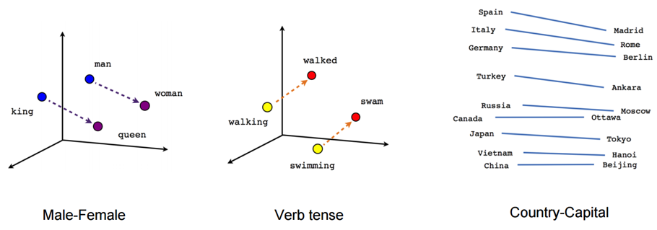
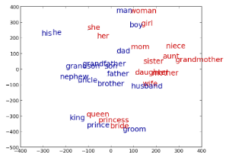
Word Embeddings: Power of Embeddings
Imagine doing simple math with words
“A is to B as C is to D” tasks
-word_{A} – word_{B} – word_{C} ≅ word
Associate Prof. Wei Liu & Tyler Bikaun, UWA
http://rare-technologies.com/word2vec-tutorial/
Notes:
Word analogies. For example: King – Man + Queen = Female
Similarity -> distance; relationship between words -> angle (the same relationship has the same angle).
Non-orthogonal vectors allows us to take advantage of these representations unlike one-hot vectors which are orthogonal e.g. 90 degrees apart

Slide 49
Word Embeddings: Analogy Task Examples
“A is to B as C is to D” tasks
groom bride husband wife groom bride king queen groom bride man woman groom bride nephew niece groom bride policeman policewoman groom bride prince princess | Athens Greece Baghdad Iraq Athens Greece Bangkok Thailand Athens Greece Beijing China Athens Greece Berlin Germany Athens Greece Bern Switzerland | short shorter small smaller short shorter smart smarter short shorter strong stronger short shorter tall taller short shorter tight tighter short shorter tough tougher short shorter warm warmer short shorter weak weaker short shorter wide wider short shorter young younger short shorter bad worse
Associate Prof. Wei Liu & Tyler Bikaun, UWA
Notes:
20,000 syntactic and semantic test examples (Google)
The top 30,000 words ranked according to frequency are used for the evaluation shown.

Slide 50
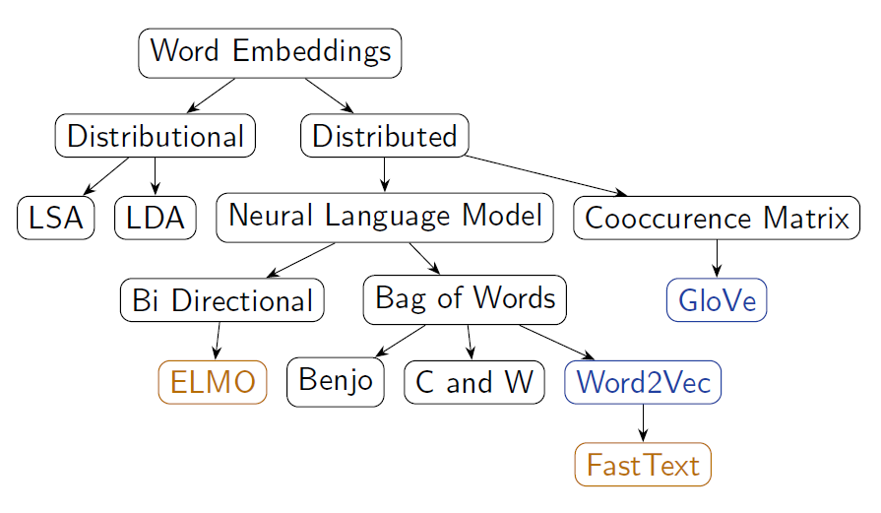
Word Embeddings: Techniques
Many ways of obtaining word vectors
New techniques are being developed every year!
Associate Prof. Wei Liu & Tyler Bikaun, UWA
Notes:
Word2Vec (neural embedding model); ‘self-supervised’
1. one-word context (predicting one word given only one word); referred to as a continuous bag of words (CBOW) model. Input is a onehot encoded vector
2. multi-word context (similar to one-word but we need in multiple words)
3. Skip-gram model (opposite to CBOW multi-word). Given word w predict n words surrounding it (windowing).
GloVe (Global Vectors for Word Representation)-> captures the meaning of a word embedding with the structure of the entire observed corpus. This model utilises word frequencies and co-occurrence counts in a unsupervised manner.
ELMO (Embeddings from Language Models)-> Context-dependent embeddings; uses language models to capture embeddings for individual words while conditioning on the entire sentence or document. Conventional embeddings have issues with polysemy e.g. “the bank on the other end of the street was robbed” vs. “we had a picnic by the bank on the river”. Many embedding models find it difficult to distinguish the difference between the use of the word bank. Elmo captures this meaning by conditioning on the context it’s in and the word vector changes based on the words around it.

Slide 51
Word Embeddings: Word2Vec(tor)
Word2Vec (Mikolov et al. 2013)
For learning word representations using a shallow neural network
No shared parameters across the network
Fast training
Training over Wikipedia snapshot (about 1 billion words) with 50 dimensions takes only 4 hours
Strong representations – previous state-of-the-art performance.
Learned word embedding vectors can be represented as linear translations etc.
vec(king) – vec(man) + vec(woman) ≅ vec(queen)
vec(Paris) – vec(France) + vec(China) ≅ Beijing)
Associate Prof. Wei Liu & Tyler Bikaun, UWA

Slide 52
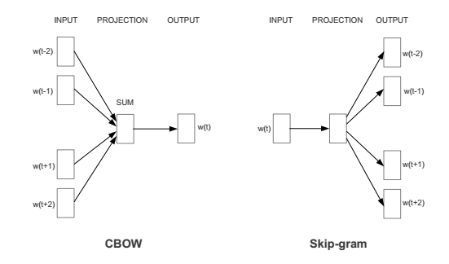
Word Embeddings: Word2Vec(tor) Continued.
Word2Vec Configurations
Word2vec has two models
Continuous Bag of Word (CBOW)
Predict a word w(t) given its context
Skip-gram models
Predict context words given a word w(t)
Associate Prof. Wei Liu & Tyler Bikaun, UWA

Slide 53
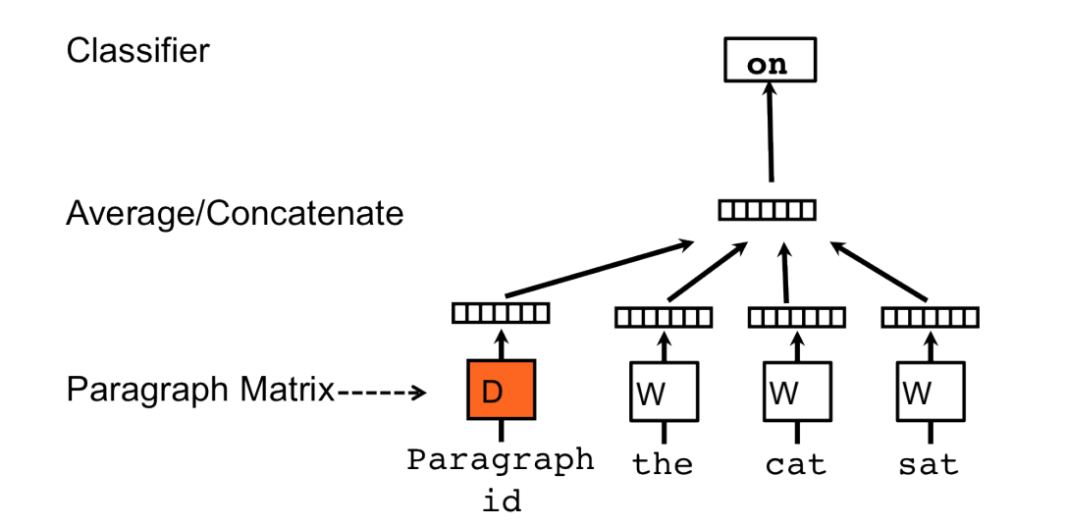
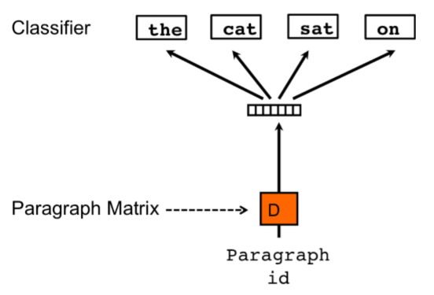
Other Language Representations
Document embedding
Different Embeddings Forms
Sentences - Sent2Vec
Paragraphs - Doc2Vec
Document topics - Top2Vec
Multi-Modal - Data2Vec
Associate Prof. Wei Liu & Tyler Bikaun, UWA
Notes:
Document embedding techniques: https://towardsdatascience.com/document-embedding-techniques-fed3e7a6a25d

Slide 54
Fundamentals of Natural Language Processing
Agenda (Hands-on Session) – Word Representations
Learning word representations from scratch
General domain and domain-specific word embeddings
Word similarity
Word vector clustering and visualisation
Supplementary Content
Interactive exploration of word2vec models: https://ronxin.github.io/wevi/
Associate Prof. Wei Liu & Tyler Bikaun, UWA Notebooks: 12.2.1 – Word vector visualization with Gensim & 12.2.2 – Learning Word Embeddings

Slide 55
12.3 Supervised Learning Learning from example

Slide 56
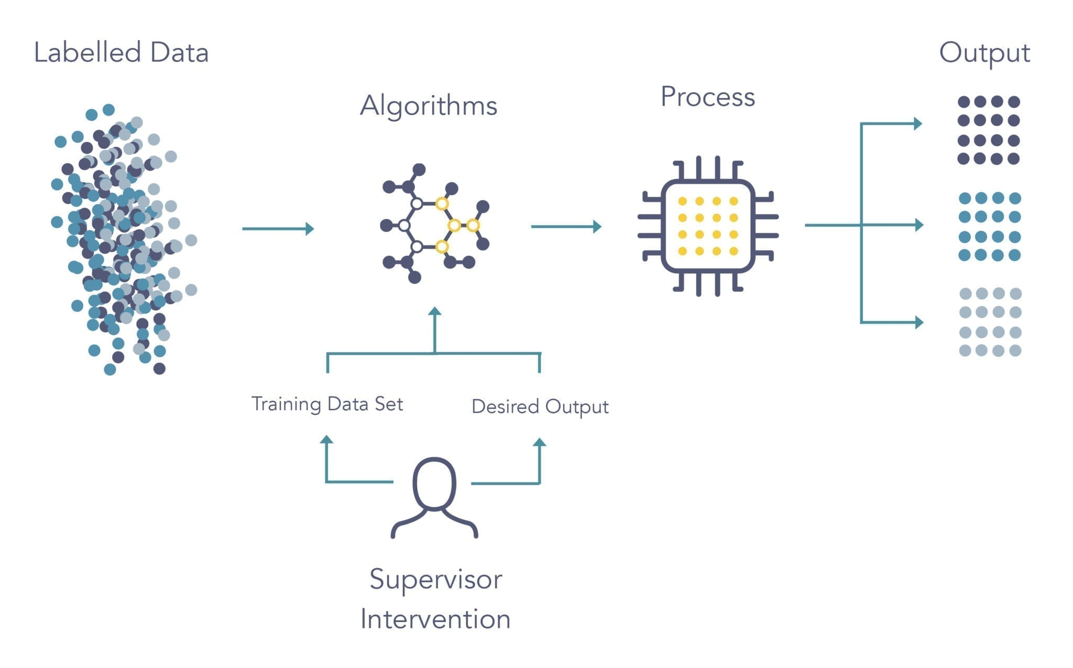
Supervised Learning
Fundamentals of Supervised Learning
Aim: Learn a complex function that maps X to y when provided a set of labelled x, y pairs as example
x,y pairs are typically acquired through human annotation using a pre-defined schema/model
Can vary in difficulty and complexity
Associate Prof. Wei Liu & Tyler Bikaun, UWA
Notes:
Ref: https://www.logpoint.com/da/blog/explained-siemply-machine-learning/

Slide 57
Supervised Learning
Agenda (Hands-on Session) – Exploring Supervised NLP Tasks using HuggingFace 🤗
Sequence Classification
Question Answering
Language Modelling
Text Generation
Named Entity Recognition
Summarization
Translation
Colab Notebook
Associate Prof. Wei Liu & Tyler Bikaun, UWA

Slide 58
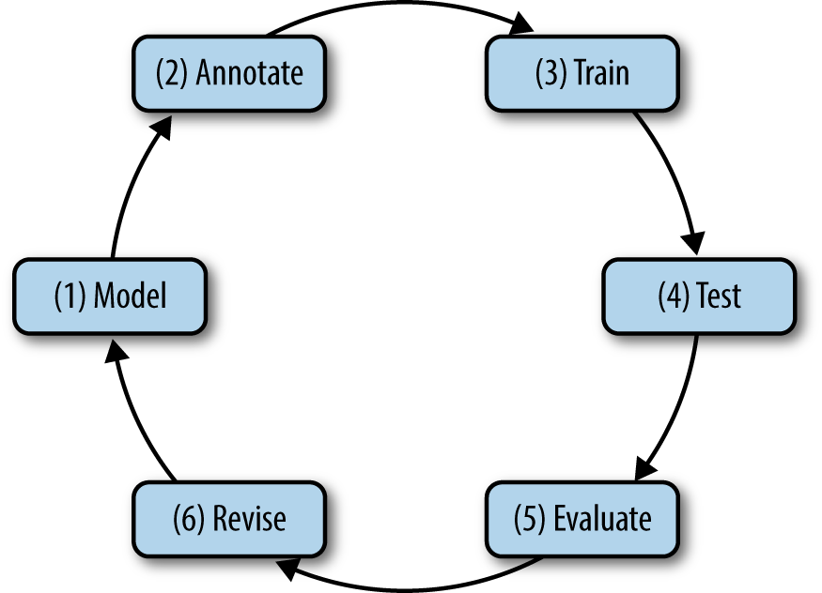
Fundamentals of Natural Language Annotation
The Annotation Development Cycle
Associate Prof. Wei Liu & Tyler Bikaun, UWA
Notes:
Natural Language Annotation for Machine Learning (Pustejovsky and Stubbs)

Slide 59
Annotation Example: Accident Report (NER)
1 - Specifying a Model for Annotation
What are the goals of the annotation task?
What are the characteristics of the dataset? Is it representative of the goals of the task? Is it balanced? What is the quality?
Does the task require subject matter experts or linguists?
Does a complete or partial model already exist?
walking in car park from office to workshop and rolled ankle
injury
activity
body part
Initial Model
Associate Prof. Wei Liu & Tyler Bikaun, UWA

Slide 60
Annotation Example: Accident Report (NER)
injury
activity
body part
2 - Performing human annotation
What tool will be used to perform annotation?
How many annotators are required to arrive at a gold standard?
What level of resources are committed to the annotation task?
How much data will be sufficient for training and testing?
activity
walking in car park from office to workshop and rolled ankle
injury
body part
Associate Prof. Wei Liu & Tyler Bikaun, UWA

Slide 61
Annotation Example: Accident Report (NER)
injury
activity
body part
3 & 4 - Training and Testing
What model architecture is best suited for the chosen task?
How will the texts be represented?
How will the model architecture be optimised?
What is the acceptable level of performance and expected bayes error rate?
activity
walking in car park from office to workshop and rolled ankle
injury
body part
Associate Prof. Wei Liu & Tyler Bikaun, UWA

Slide 62
Annotation Example: Accident Report (NER)
injury
activity
body part
5 – Evaluation of Model Performance
Does the model meet the acceptable level of performance?
What does the model do well at, what does the model struggle with?
activity
walking in car park from office to workshop and rolled ankle
injury
body part
Associate Prof. Wei Liu & Tyler Bikaun, UWA

Slide 63
Annotation Example: Accident Report (NER)
6 – Revising the Model
Does the model meet the goals of the task? If not, what modifications need to be made?
How are the annotators performing? Is the task too challenging?
walking in car park from office to workshop and rolled ankle
injury
activity
body part
location
New Model
Associate Prof. Wei Liu & Tyler Bikaun, UWA

Slide 64
Annotation Example: Accident Report (NER)
activity
location
location
location
walking in car park from office to workshop and rolled ankle
injury
body part
Associate Prof. Wei Liu & Tyler Bikaun, UWA

Slide 65
Annotation Example: Accident Report (ET)
location
location/car park
location location/office
location
location/workshop
walking in car park from office to workshop and rolled ankle
activity
activity/walking
injury injury/sprain
body part body part/leg
body part/leg/ankle
Associate Prof. Wei Liu & Tyler Bikaun, UWA

Slide 66
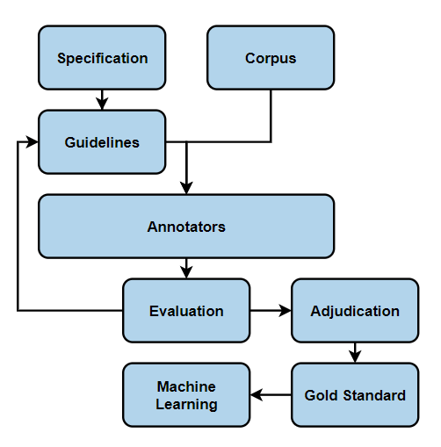
Fundamentals of Natural Language Annotation
After Development - The Annotation Cycle
Specification: model of phenomena for a specific task
Guidelines: helps annotators reliably label or tag the corpus
Annotators: recruited or crowd sourced humans
Evaluation: inter-annotator agreement
Adjudication: creating a gold-standard annotated corpus
Machine Learning: using annotations for supervised learning
Associate Prof. Wei Liu & Tyler Bikaun, UWA
Notes:
Natural Language Annotation for Machine Learning (Pustejovsky and Stubbs)

Slide 67
12.4 Unsupervised Learning Learning without example

Slide 68
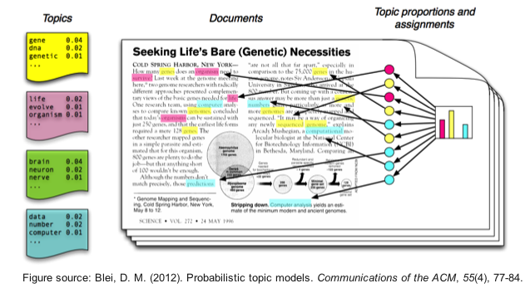
Unsupervised Learning: Topic Modelling
Suppose you have the following set of sentences:
I eat fish and vegetables.
Fish are pets.
My kitten eats fish.
Latent Dirichlet allocation (LDA) is an unsupervised topic modelling algorithm that automatically discovers topics that these documents contain.
bold words under the Topic F, which we might label as “food“
italics words might be classified under a separate Topic P, which we might label as “pets“
https://www.quora.com/What-is-the-best-way-to-explain-topic-modeling-to-a-layman
Associate Prof. Wei Liu & Tyler Bikaun, UWA

Slide 69
Unsupervised Learning: Topic Modelling
LDA defines each topic as a bag-of-words (bow), and you have to label the topics as you deem fit.
We can infer the content spread of each sentence by a word count
Sentence 1 (I eat fish and vegetables): 100% Topic F
Sentence 2 (Fish are pets): 100% Topic P
Sentence 3 (My kitten eats fish): 33% Topic P and 67% Topic F
We can derive the proportions that each word constitutes in given topics. For example, Topic F might comprise words in the following proportions: 40% eat, 40% fish, 20% vegetables, …
Associate Prof. Wei Liu & Tyler Bikaun, UWA

Slide 70
Unsupervised Learning: Topic Modelling
Three Steps
LDA defines each topic as a bag-of-words (bow), and you have to label the topics as you deem fit.
Specify how many latent topics are there
For each word, assign a temporary topic, according to a Dirichlet distribution, e.g. kitten -> F
If a word appears twice, each word may be assigned to different topics.
Function words (e.g. “the”, “and”, “my”) are removed and not assigned to any topics.
Topic assignment is updated based on two criteria:
How prevalent is that word across topics?
How prevalent are topics in the document?
Associate Prof. Wei Liu & Tyler Bikaun, UWA

Slide 71
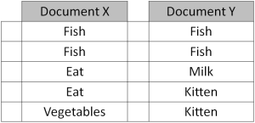
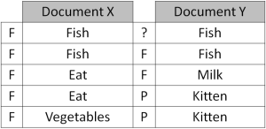


Unsupervised Learning: Topic Modelling
Repeated refinement
The process of checking topic assignment is repeated for each word in every document, cycling through the entire collection of documents multiple times.
This iterative updating is the key feature of LDA that generates a final solution with coherent topics.
Associate Prof. Wei Liu & Tyler Bikaun, UWA

Slide 72
Unsupervised Learning
Agenda (Hands-on Session) – Topic Modelling using Latent Dirichlet Allocation (LDA)
Corpus pre-processing including lemmatization
Training LDA model from scratch
Interactive visualisation of LDA model
Exploration of LDA features
Associate Prof. Wei Liu & Tyler Bikaun, UWA Notebook: 12.3 – Topic Modelling using LDA

Slide 74
Additional Content

Slide 75
NLP Pipelines – Ontology Learning from Text
Knowledge Representation
Machine Learning
Computational Linguistic
Graphs in knowledge representation
Two different sources
Knowledge experts (logic based)
Knowledge discovery (from natural language texts)
Ontology learning
Entity Extraction
Symbolic
Unsupervised learning
Supervised learning
Subsymbolic
Deep learning
Entity Relation Extraction
Associate Prof. Wei Liu, UWA

Slide 76


Lightweight Ontologies
Overview – What’s Light Weight Ontology
Wilson Wong, Wei Liu, and Mohammed Bennamoun. (2012) Ontology Learning from Text: A look back and into the future, ACM COMPUTING SURVEYS, 44, 4, Article 20, pp. 20:1-20:36
Associate Prof. Wei Liu, UWA

Slide 77
text > sets of corpora are prepared for ontology construction. Web Crawling is performed to gather web pages from general sources such as Reuters, Discovery and CNet to create the Contrastive Corpus. Readily available non-domain specific
Lightweight Ontologies
texts
term candidates
terms
Text Preprocessing
Text Processing
Term Recognition
Relation Acquisition
parse HTML/XML files for texts.
segment texts to identify sentences.
remove noise.
parse sentences for part-of-speech and grammatical information.
extract noun phrases as term candidates and measure their collocational strength (i.e. unithood).
determine the relevance of term candidates with respect to a domain (i.e. termhood) using text corpora.
acquire semantic relations between terms.
[University of WA]
[education]
[next year]
[Perth]
…
How is [University of WA] related to [education]
...University of WA… universities of Perth...
...[University of WA]…[universities] of [Perth]….
1

Slide 78

Ontology Learning from Text – System Overview
A semi-automatic ontology learning system
Wei Liu, Arno Scharl & Albert Weischselbraun, 2005
Associate Prof. Wei Liu, UWA

Slide 79

Ontology Learning from Text – Term Co-ocurrence
Semantic Network
Visualisation
Associate Prof. Wei Liu, UWA

Slide 80


Ontology Learning from Text – Term Significance
Results of climate change data analysis
Associate Prof. Wei Liu, UWA

Slide 81

Ontology Learning from Text – Building Lightweight Ontologies
Spreading Activation
Associate Prof. Wei Liu, UWA

Slide 82
12.4 Neural Language Processing

Slide 83



Sequence to Sequence Learning (Encode then Decode)
Associate Prof. Wei Liu, UWA

Slide 84

LSTM
Contains four interacting layers
Associate Prof. Wei Liu, UWA

Slide 85

LSTM
Inside a cell
Associate Prof. Wei Liu, UWA

Slide 86

LSTM – Forget gate
http://colah.github.io/posts/2015-08-Understanding-LSTMs/

Slide 87


LSTM – Input Gate Layer
$$b_{C})$$
Associate Prof. Wei Liu, UWA

Slide 88

LSTM - Update
Associate Prof. Wei Liu, UWA

Slide 89

LSTM – Output Gate
Associate Prof. Wei Liu, UWA

Slide 90
Sequence to Sequence Learning (Encode then Decode)
Associate Prof. Wei Liu, UWA

